Slide 1
Machine Learning Explorer for Metal-Organic Architectures
Project Update
18.09.2023

Slide 2
Can we discover novel metal-organic architectures by leveraging machine learning and high-throughput screening to reveal untapped regions of a chemical space, thus departing from conventional analogue-based approaches?

Slide 3
To what extent can machine learning and high-throughput screening truly impact discovery in “non-cherry-picked” scenarios?
What are the limitations in the deployment of machine learning when you have limited data (i.e., what can be reasonably obtained through high-throughput screening within practical time and cost constraints?)

Slide 4
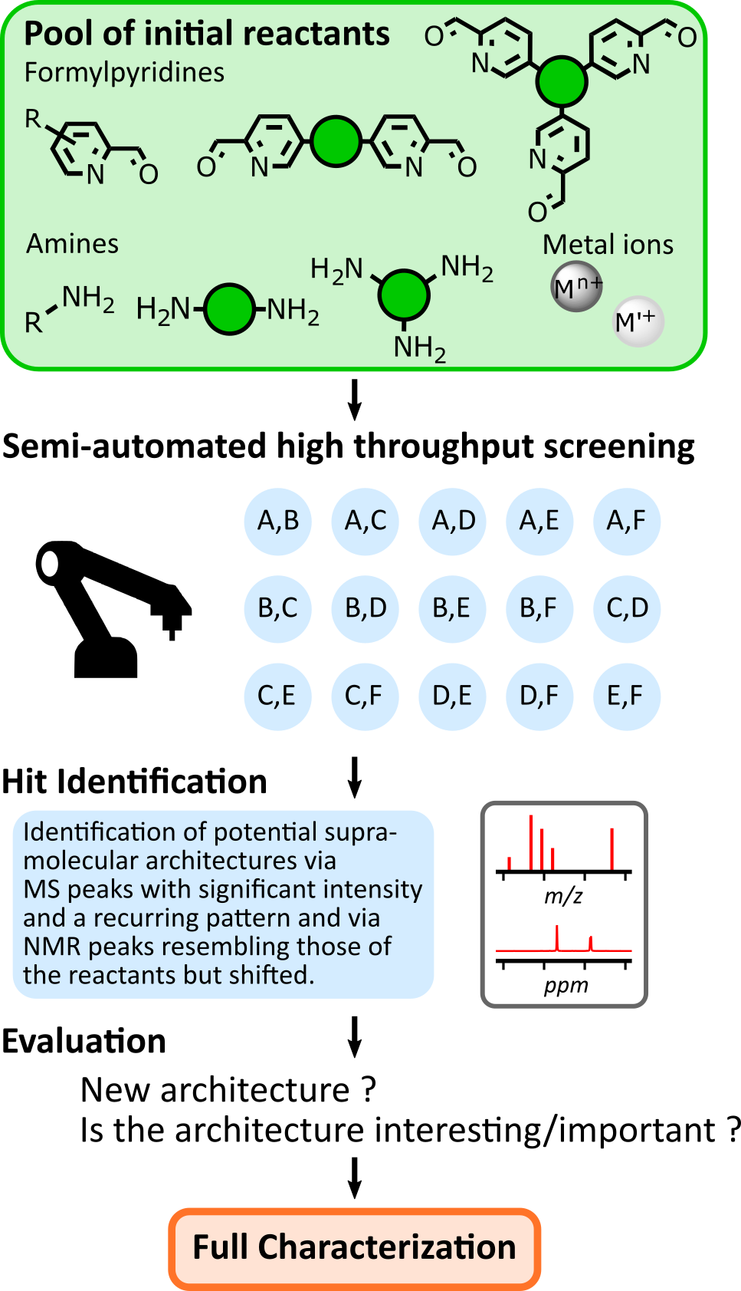
Stage I. Creation of an “information rich” database of metal-organic reactions using semi-automated high throughput screening.

Slide 5
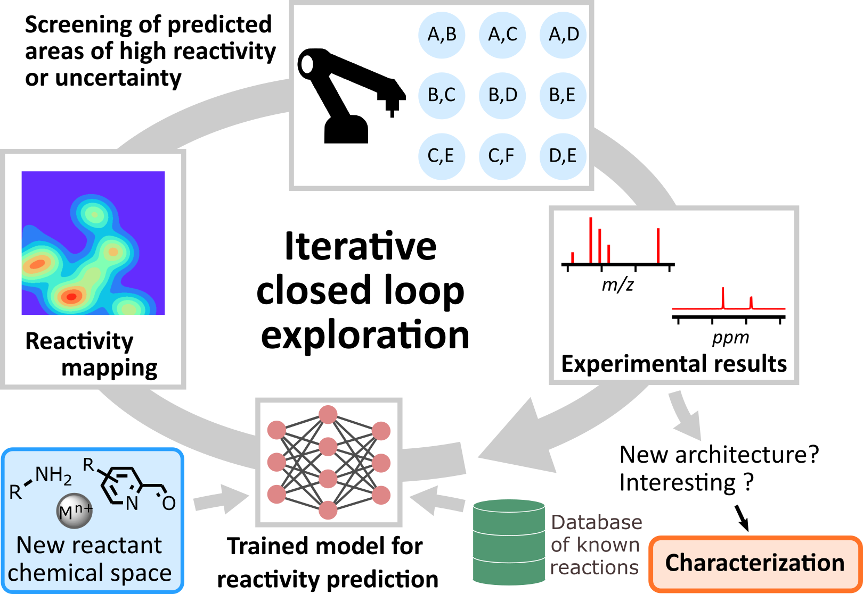
Stage II. Training of a machine learning model to predict reactivity, potentially progressing towards an iterative closed-loop exploratory workflow.

Slide 6
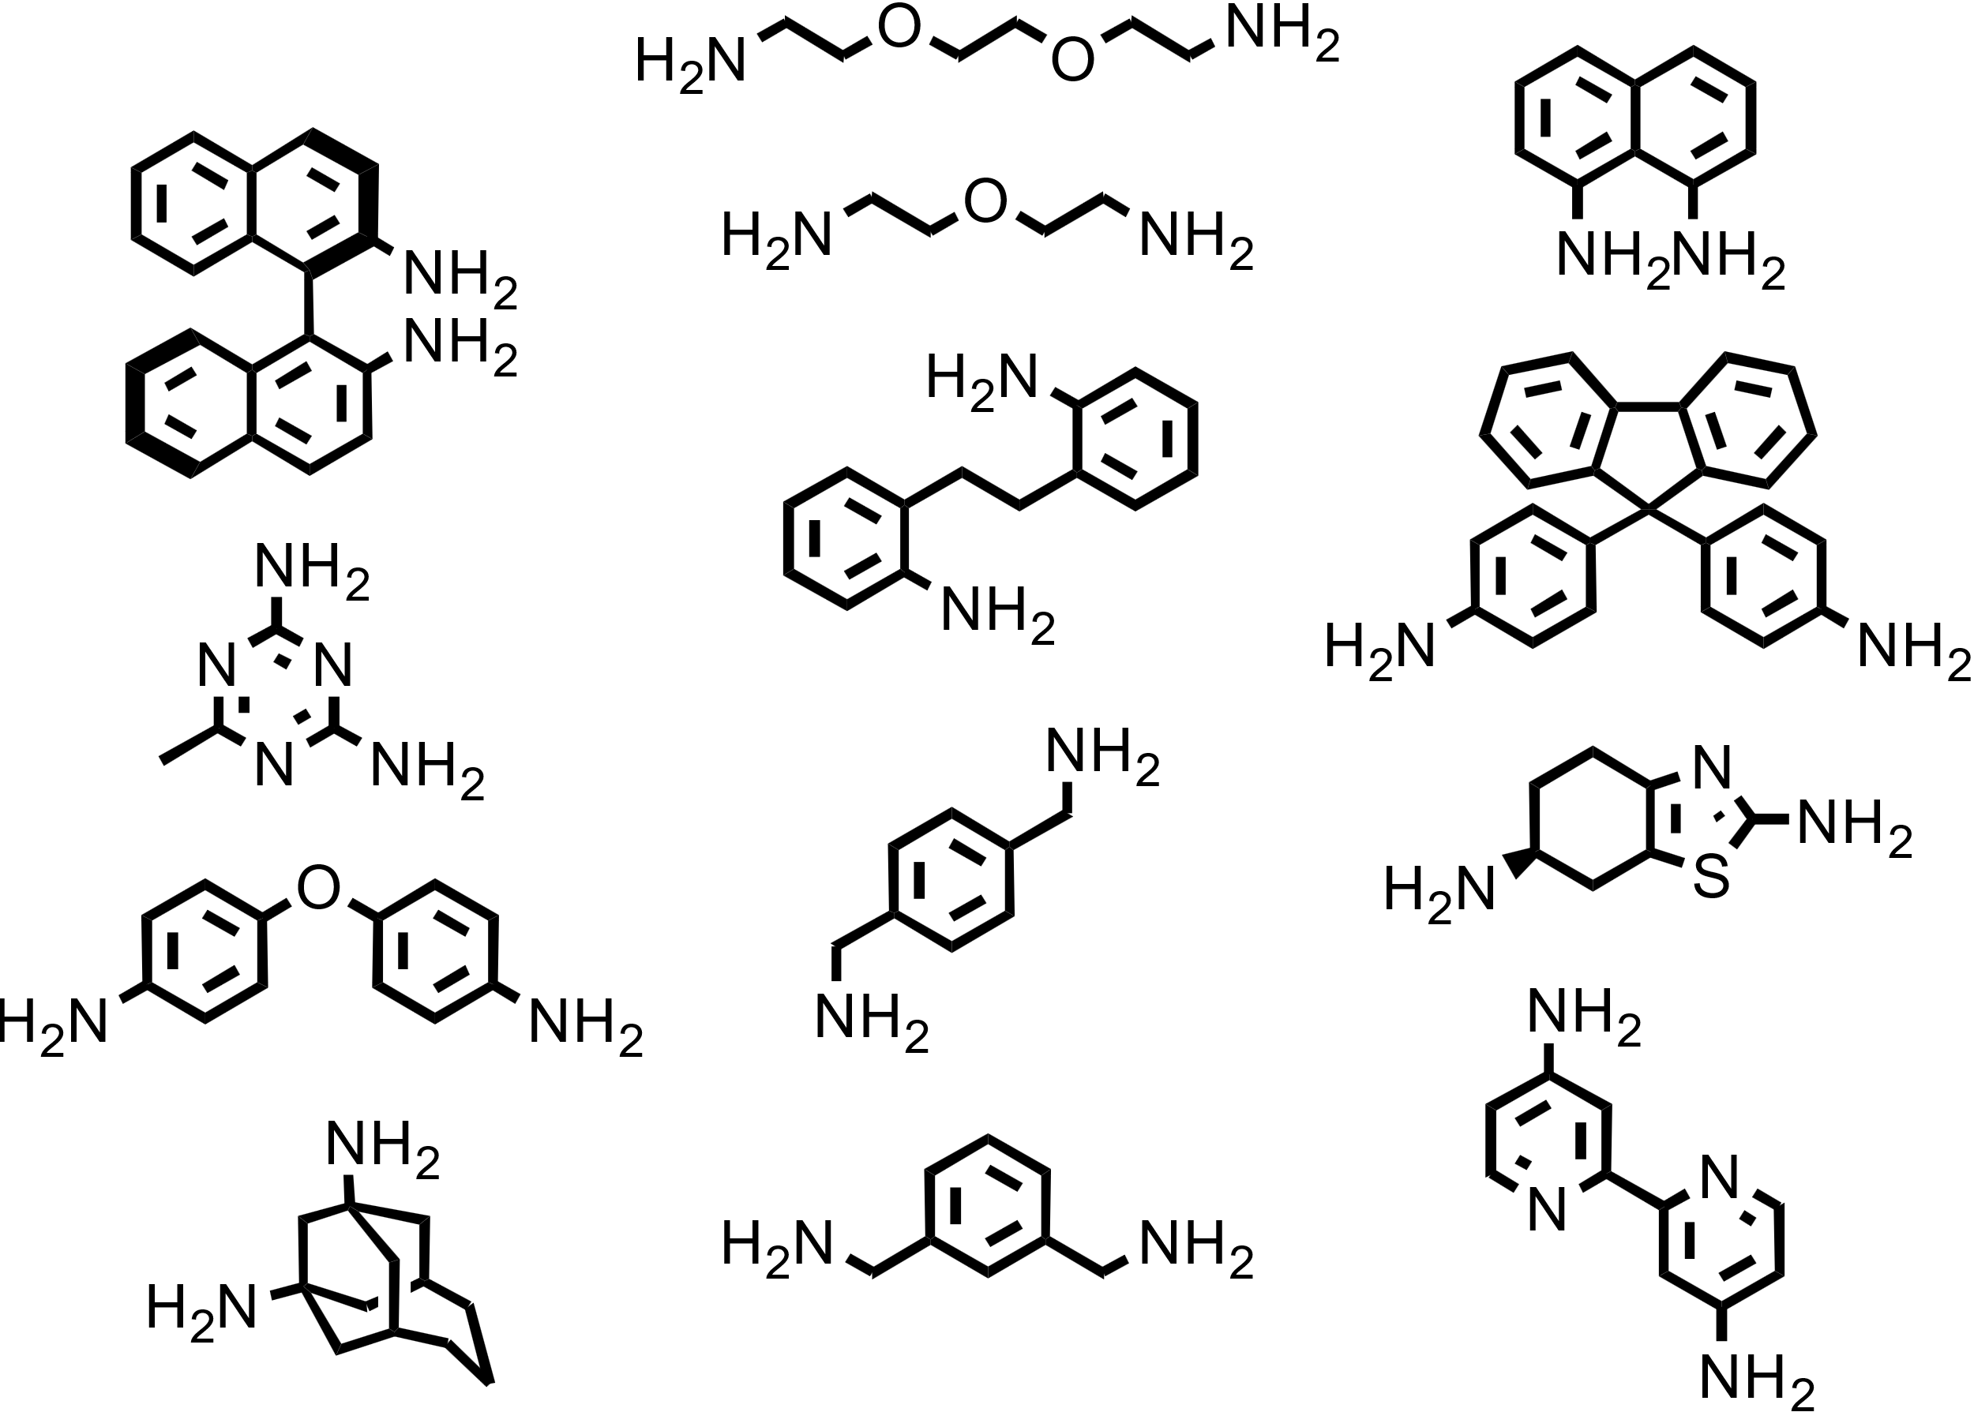
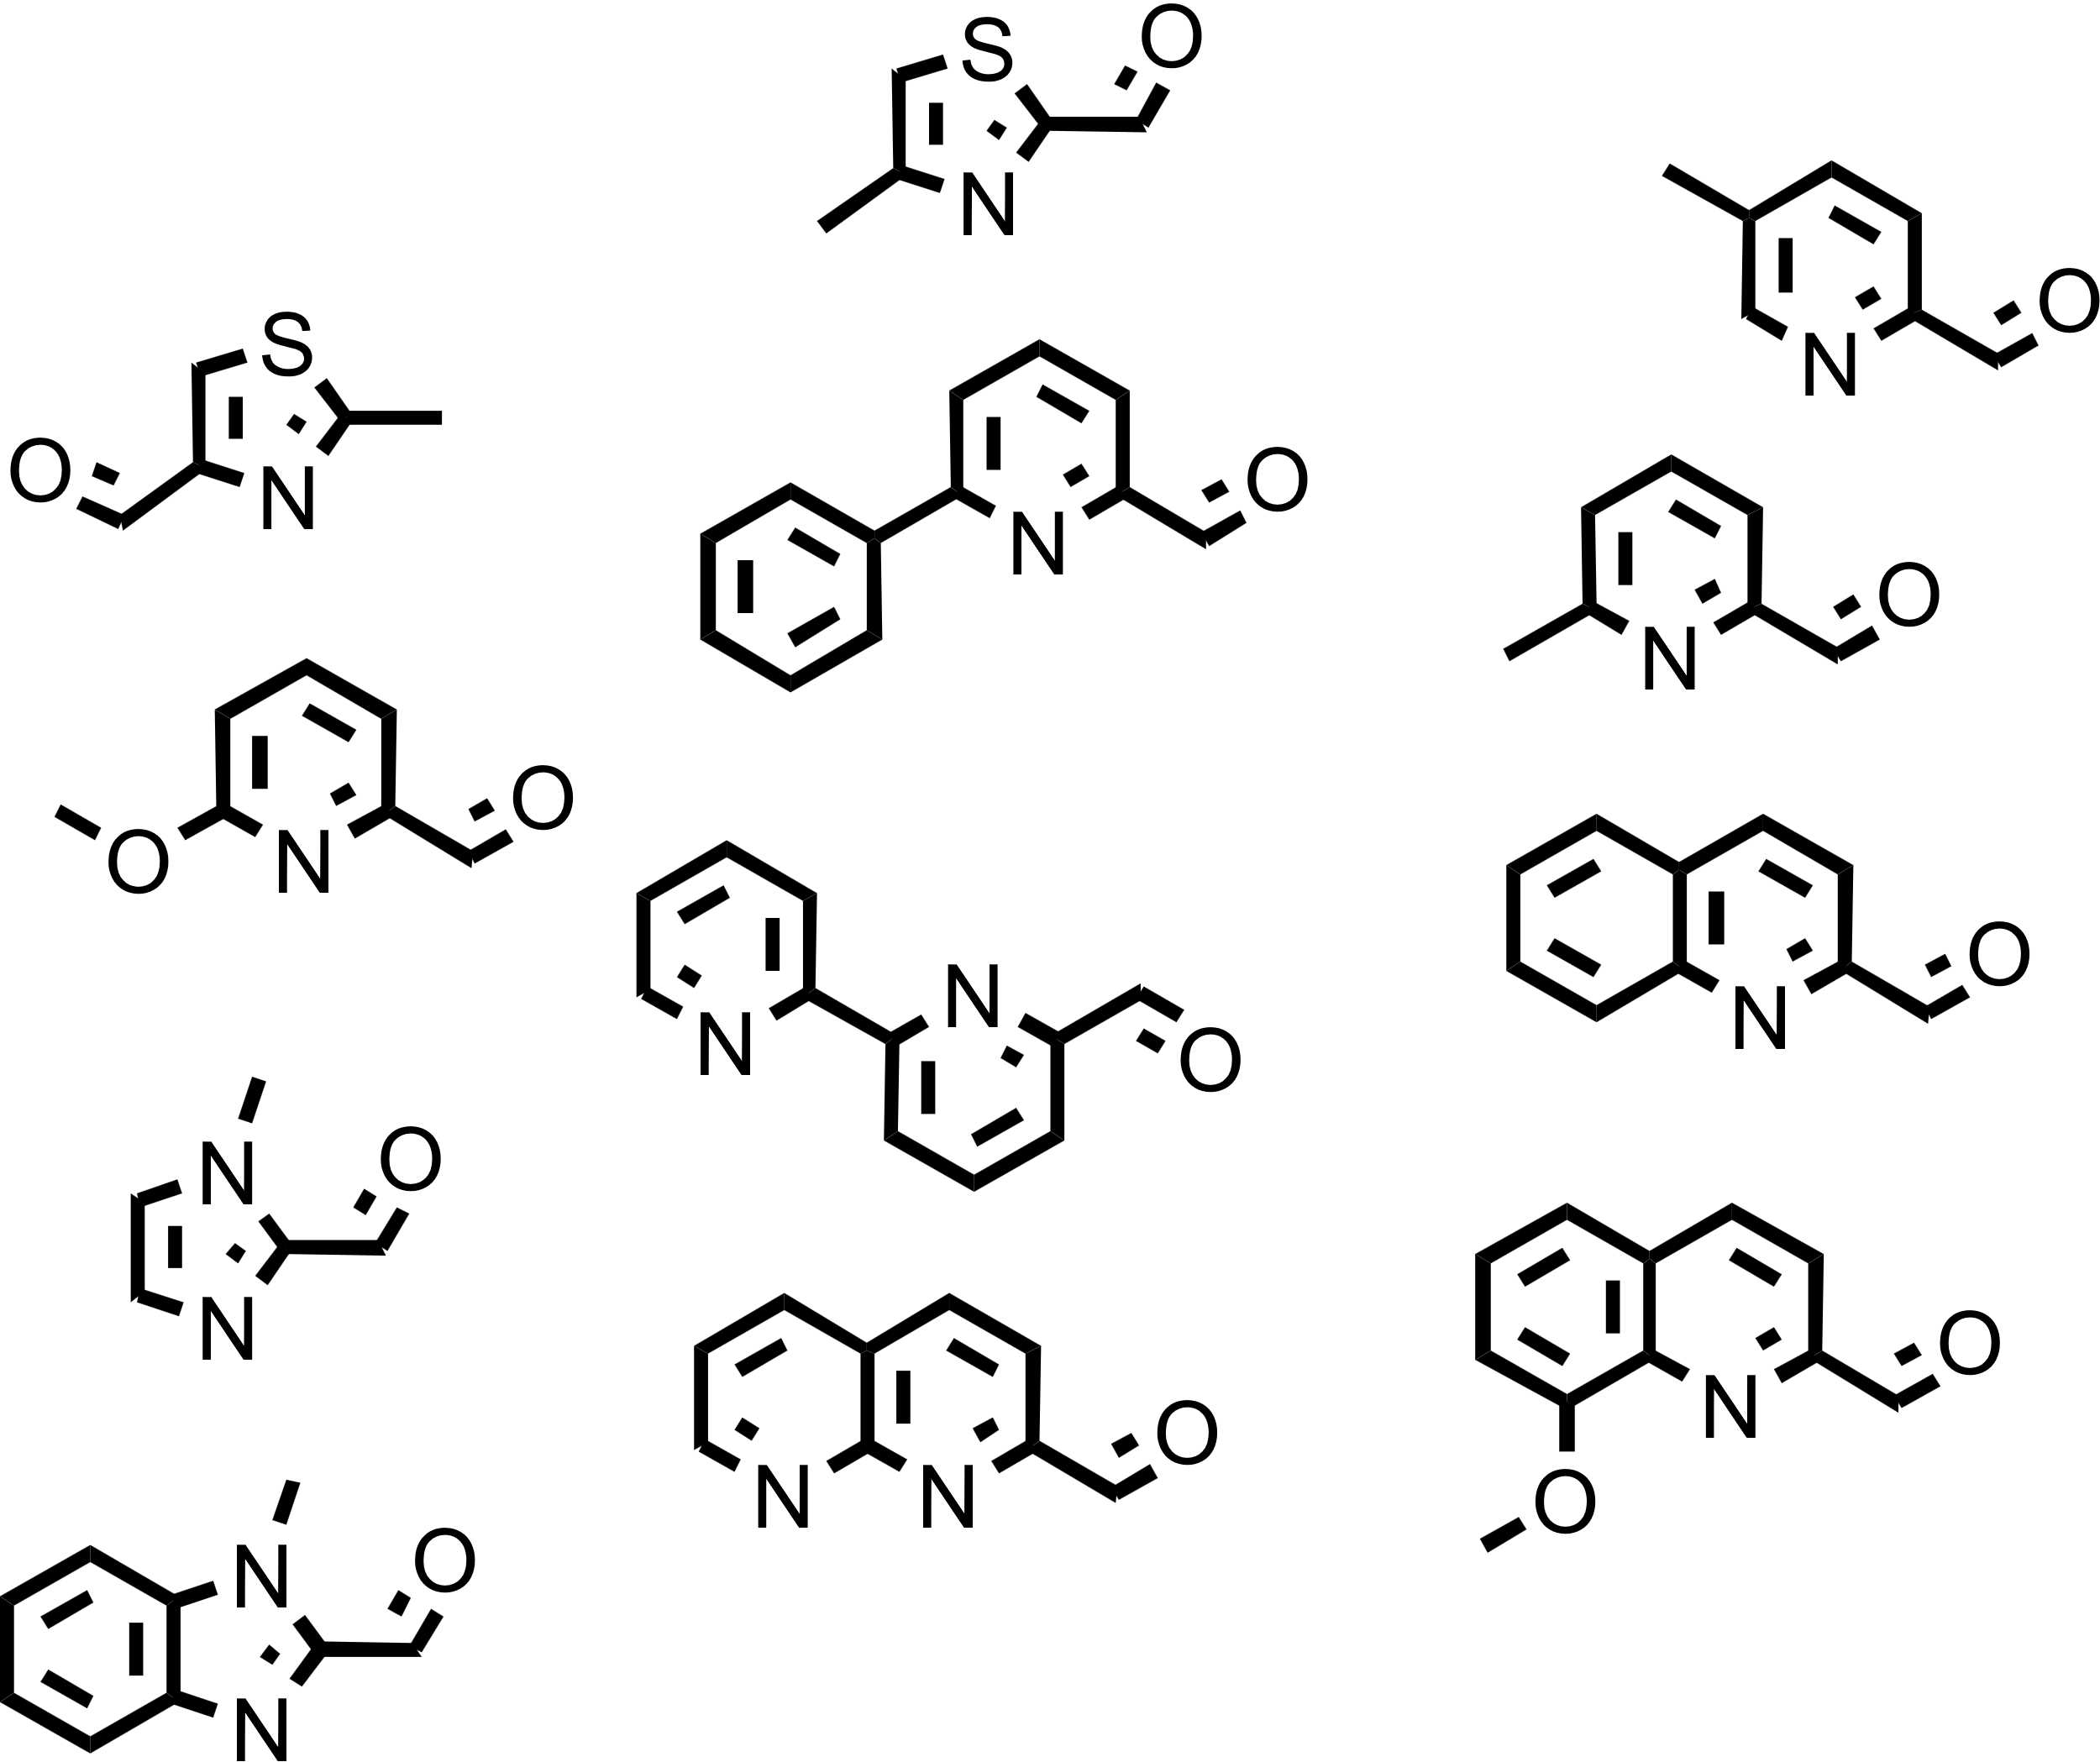
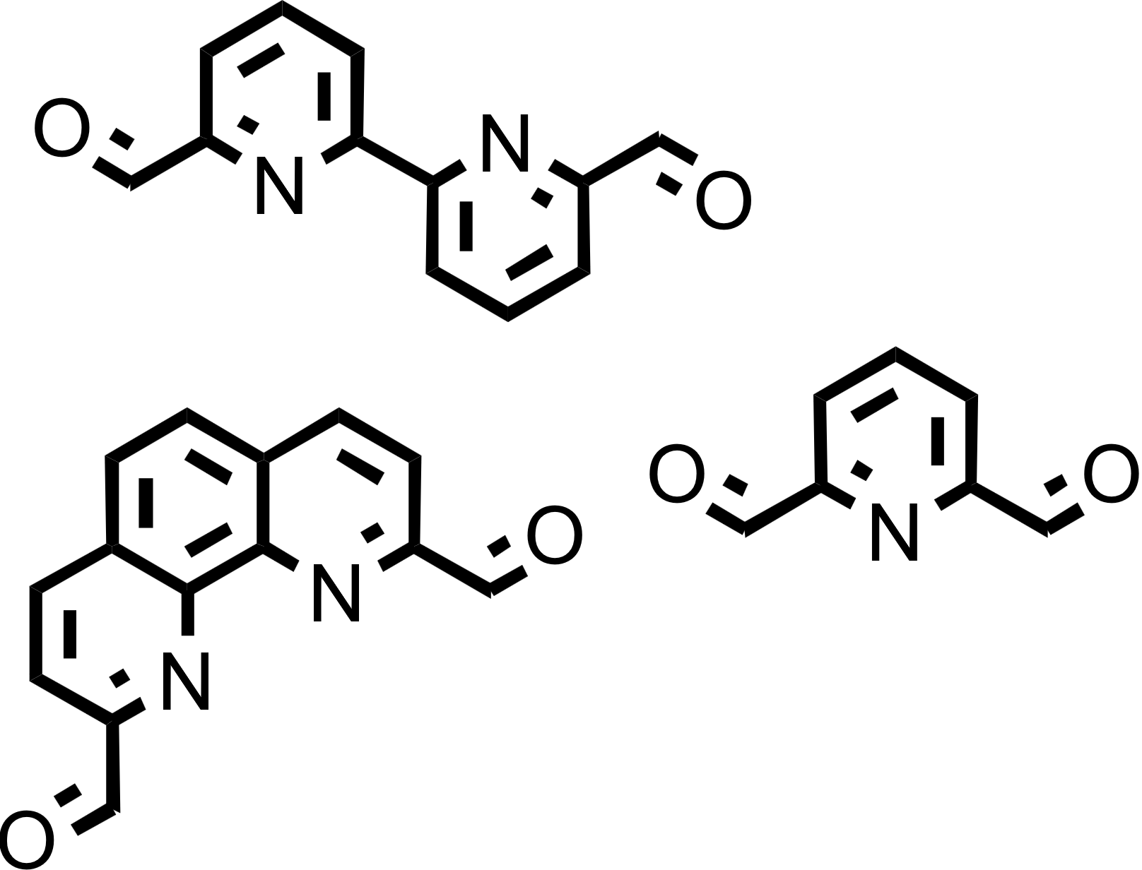
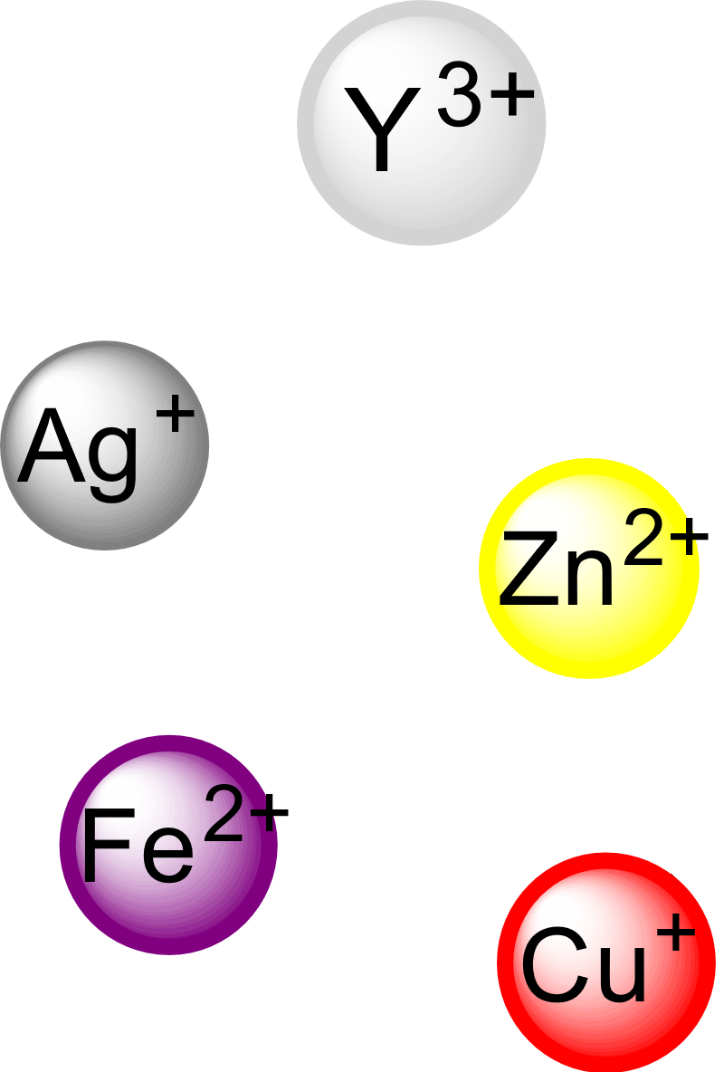
Select a complex chemical space that cannot be rationalized instinctively, use very minimalistic and open criteria for building blocks selection.
12 Aldehydes
13 Diamines
3 Dialdehydes
5 Metals

Slide 7
12 Aldehydes
13 Diamines
3 Dialdehydes
5 Metals
Considering all reactions with:
One Metal, One Diamine, One Aldehyde
Two Metals, One Diamine, One Aldehyde
One Metal, One Diamine, One Dialdehyde
Two Metals, One Diamine, One Dialdehyde
One Metal, One Diamine, One Aldehyde, One Dialdehyde
Two Metals, One Diamine, One Aldehyde, One Dialdehyde
≈9900 combinations

Slide 8
12 Aldehydes
13 Diamines
3 Dialdehydes
5 Metals
Considering all reactions with:
One Metal, One Diamine, One Aldehyde
Two Metals, One Diamine, One Aldehyde
One Metal, One Diamine, One Dialdehyde
Two Metals, One Diamine, One Dialdehyde
One Metal, One Diamine, One Aldehyde, One Dialdehyde
Two Metals, One Diamine, One Aldehyde, One Dialdehyde
≈780 combinations

Slide 9
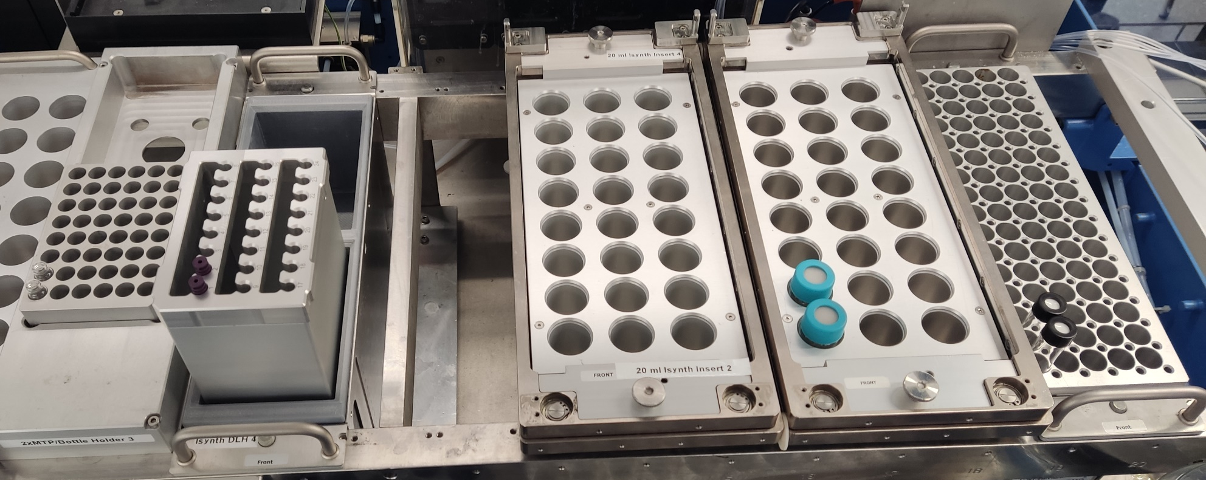
Automated (on Chemspeed Swing):
Stock solution preparation from preloaded solids
Reaction mixture preparation
NMR tube and MS vial preparation
Not Automated:
Delivery of the NMR tubes and MS vials to the respective machine (except if you want to buy a Boston Dynamic dog)

Slide 10
Automated (on Chemspeed Swing):
Stock solution preparation from preloaded solids
Reaction mixture preparation
NMR tube and MS vial preparation
Not Automated:
Delivery of the NMR tubes and MS vials to the respective machine (except if you want to buy a Boston Dynamic dog)
Stock solution
- Add CH₂Cl₂ => shake 5 min
- Add CH₃CN => shake 5 min

Slide 11
Automated (on Chemspeed Swing):
Stock solution preparation from preloaded solids
Reaction mixture preparation
NMR tube and MS vial preparation
Not Automated:
Delivery of the NMR tubes and MS vials to the respective machine (except if you want to buy a Boston Dynamic dog)
Reaction mixture
- Transfer reagents 200 µL each
- Add CH3CN
- Heat at 60 ˚C for 48h
- Cooldown 2 h

Slide 12
Automated (on Chemspeed Swing):
Stock solution preparation from preloaded solids
Reaction mixture preparation
NMR tube and MS vial preparation
Not Automated:
Delivery of the NMR tubes and MS vials to the respective machine (except if you want to buy a Boston Dynamic dog)
NMR tubes
- Transfer 600 µL from reaction to NMR tube

Slide 13
Automated (on Chemspeed Swing):
Stock solution preparation from preloaded solids
Reaction mixture preparation
NMR tube and MS vial preparation
Not Automated:
Delivery of the NMR tubes and MS vials to the respective machine (except if you want to buy a Boston Dynamic dog)
MS vials
- Transfer 10 µL from reaction to vial.
- Add 900 µL of CH₃CN

Slide 14
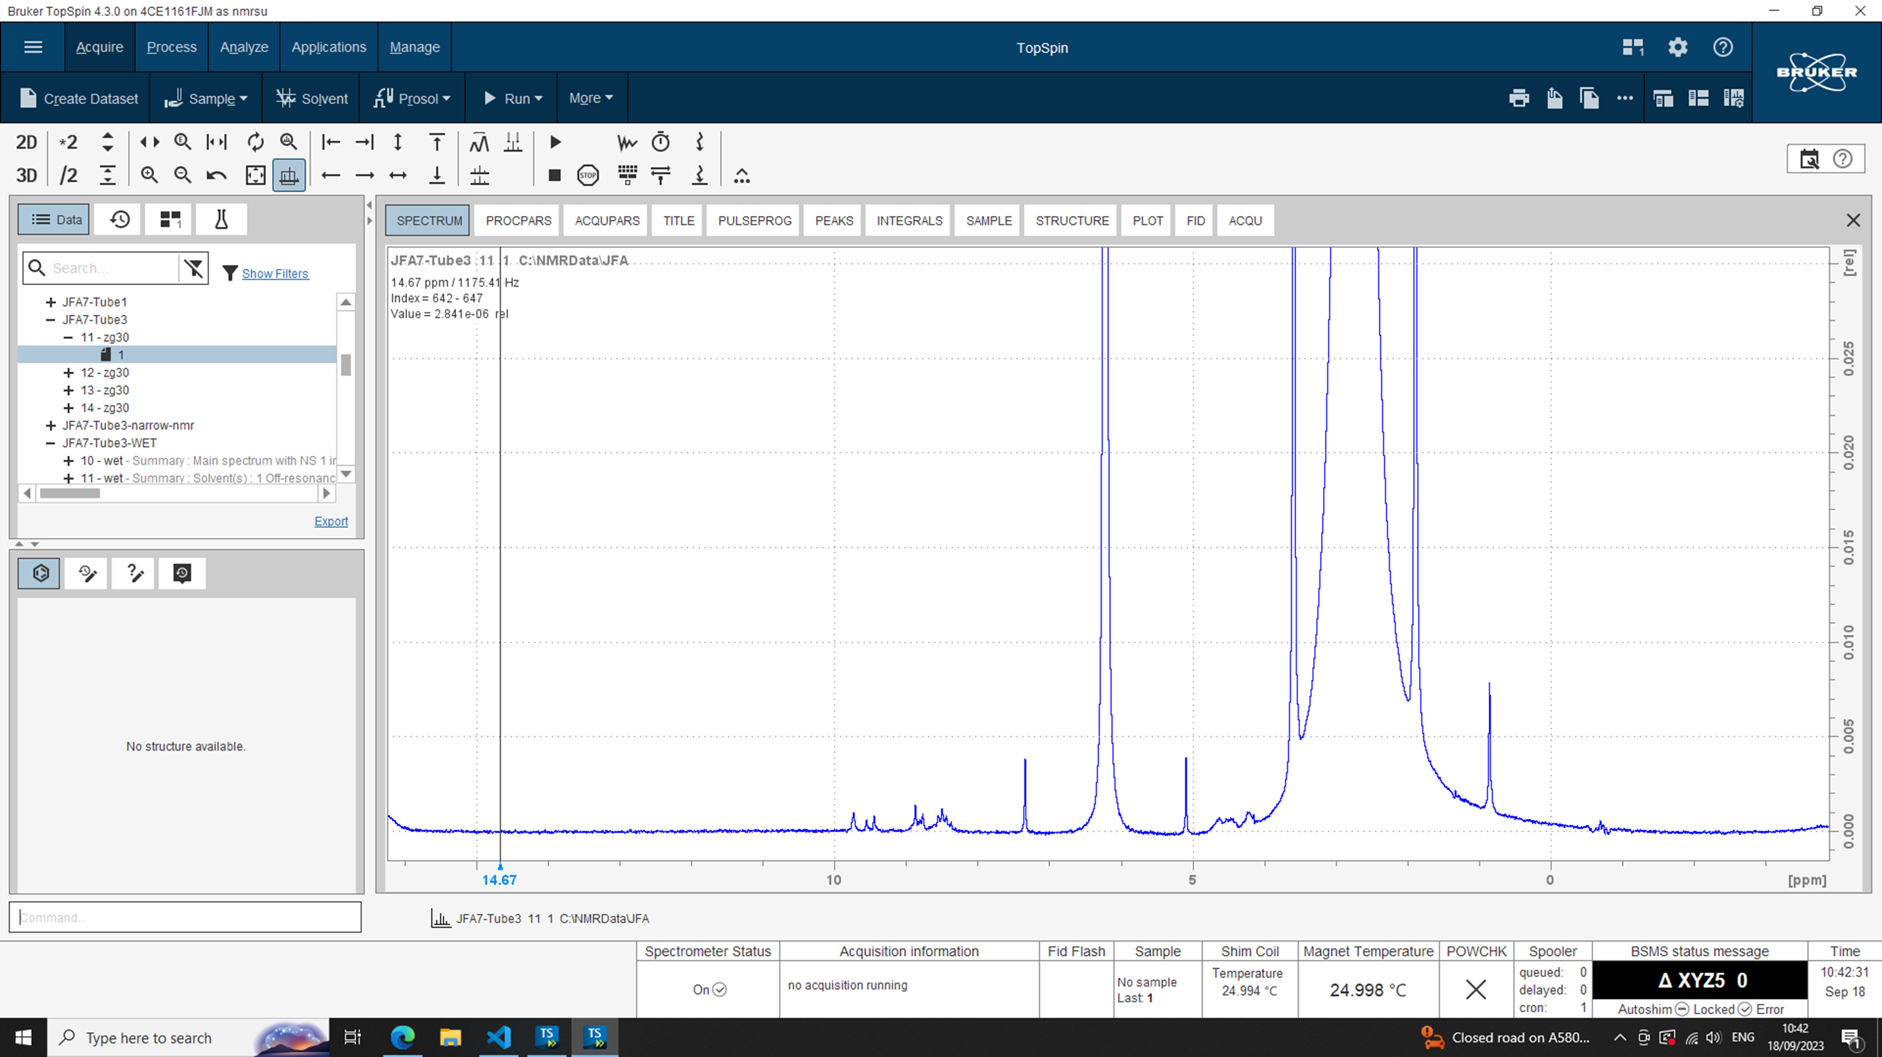
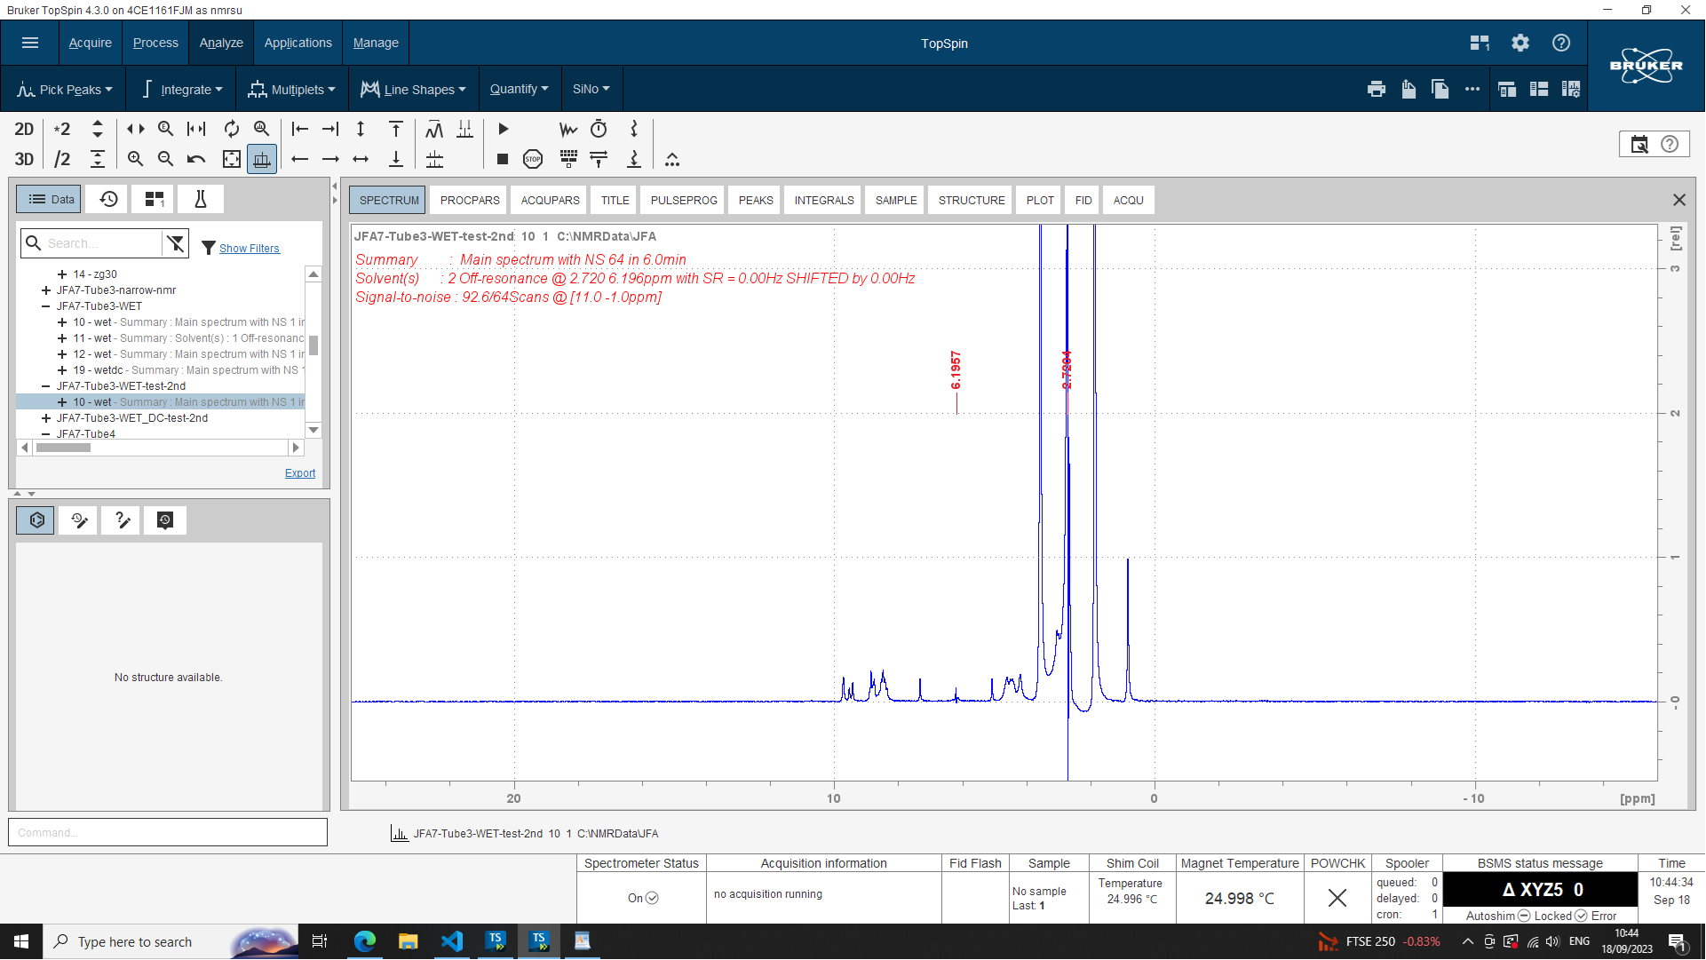
NMR of crude reaction mixture
CH₂Cl₂ was selected in place of CHCl₃ so no overlap between solvent and products peaks.
WET solvent suppression works perfectly to suppress both solvent signals.
The resolution of the machine and concentration of the reactions are good enough to have exploitable NMR.
80 MHz, CH₂Cl₂ / CHCl₃, no solvent suppression 64 scans, 5.3 mM
80 MHz, CH₂Cl₂ / CHCl₃, WET solvent suppression, 64 scans, 5.3 mM

Slide 15
Generating relevant features for machine learning
For molecular descriptors:
SMILES,
Morgan fingerprint,
Simulated IR
For features influencing the architecture formed:
Number of atoms in the shortest pass between the two amines,
Flexibility of the amine,
Enforced angle between the two amines
For features influencing the formation of the complex:
Nature of the amine (alkyl or aryl),
Partial charge on the amine
13 Diamines

Slide 16
Generating relevant features for machine learning
For molecular descriptors:
SMILES,
Morgan fingerprint,
Simulated IR
For features influencing the architecture formed:
Size of the ring,
Substitution in alpha of the nitrogen with VdW volume
For features influencing the formation of the complex:
Partial charge on the nitrogen,
Partial charge on the aldehyde
12 Aldehydes

Slide 17
Generating relevant features for machine learning
5 Metals
For features influencing the architecture formed:
Preferred coordination geometry,
Number of coordination sites
For features influencing the formation of the complex:
Size cation,
Charge of the cation

